Slide 1
DATA STRUCTURE

Slide 2
CHAPTER 7
TREE

Slide 3
TREE
We see tree in nature. The tree has root, branches, sub-branches and leaves. From the concept of natural tree, the computer scientists get the idea of a data structure, which is graphically similar to natural tree.
Natural tree is a bottom-up figure. However, the graphical representation of the data structure tree is a top-down figure.

Slide 4
TREE
A tree is a finite collection of nodes that has one to many relationship among nodes.
A tree is a hierarchical structure.
An ordered tree is a list of nodes that has a specially designated node called root node.
The connection line between two nodes is called edge.
The node that has no child node is called leaf node. The node that has child node is called parent node.
A tree can be implemented (stored in memory) as an array or a linked list.

Slide 5
TREE
Root Node
1
Level -1
15
17
11
Level -2
25
51
25
14
19
Level -3
18
15
12
Level -4
Figure 7.1: A Tree

Slide 6
Binary Tree
  A binary tree is finite set of nodes, where there is a special node called root node and every node (including root node) has at best two children.
  The trees excluding root node are called left sub-tree and right sub-tree.

Slide 7
Binary Tree
Each node can have at most 2 children
10
15
7
22
9
4
19
17
5
52
32
Slide 7

Slide 8
Binary Tree
10
Left sub-tree
15
11
Right sub-tree
25
51
25
19
18
15
12
Figure 7.2: A binary tree

Slide 9
Parts of a Tree
Node
Edges
Slide 9

Slide 10
Parts of a Tree
Root
or
Parent node
Slide 10

Slide 11
Parts of a Tree
parent node
child nodes
Slide 11

Slide 12
Parts of a Tree
parent node
child nodes
Slide 12

Slide 13
Parts of a Tree
root node
Slide 13

Slide 14
Parts of a Tree
leaf nodes
Slide 14

Slide 15
Parts of a Tree
Left sub-tree
Slide 15

Slide 16
Parts of a Tree
Right sub-tree
Slide 16

Slide 17
Parts of a Tree
sub-tree
Slide 17

Slide 18
Parts of a Tree
sub-tree
Slide 18

Slide 19
Array Representation of a Tree
0, 1, 2, 3, . . .are positions or indices
0
E
1
D
H
2
B
K
3
4
5
6
G
7
8
0
1
2
3
4
5
6
7
8
E | D | H | B |  | K |  |  | G
Slide 19

Slide 20
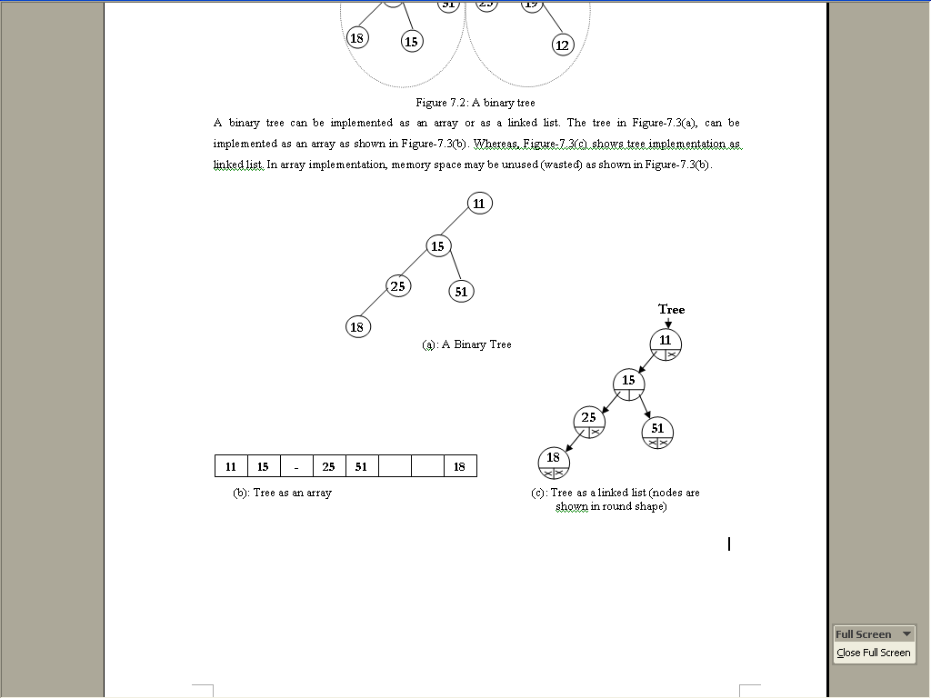
Binary Tree Representation

Slide 21
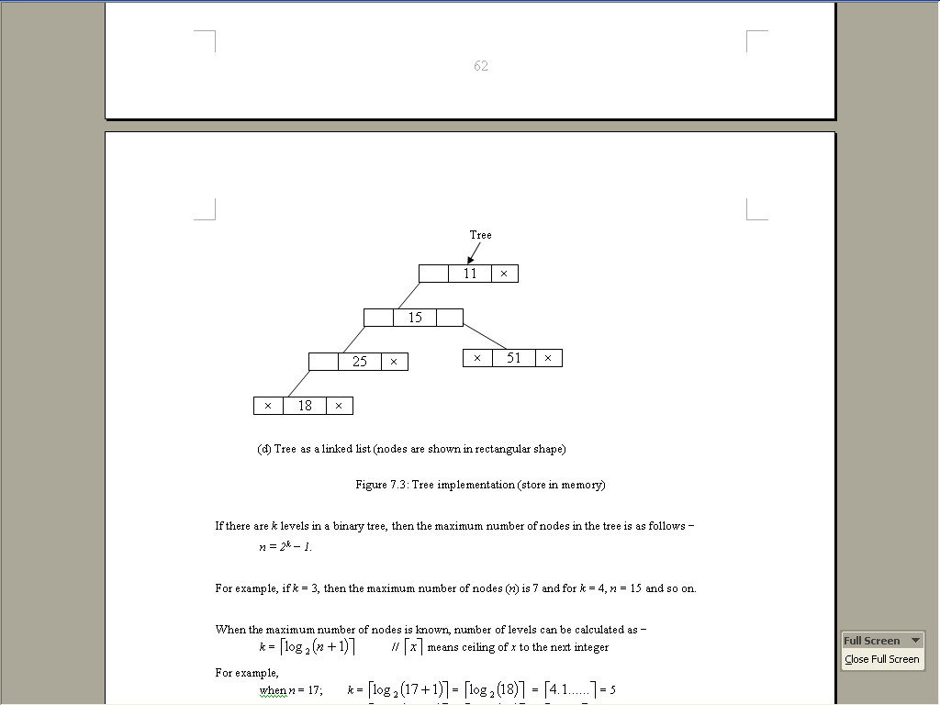
Binary Tree

Slide 22
Binary Tree
Full binary tree:
  If a binary tree contains nodes in such a way that every node has at least two children except the leaf nodes, then the tree is called a full binary tree.
Complete binary tree:
  If a binary tree contains nodes in such a way that every level except the deepest(last) has as many nodes as possible and the nodes of the deepest level are in as left as possible, the tree is called complete binary tree.(online picture)
  All full binary trees are complete binary trees.

Slide 23
Binary Tree
18
1
7
25
15
11
95
11
28
30
25
51
25
19
33
47
51
13
36
40
66
90
18
15
(a) A Full Tree
(b) A Complete Tree
Figure 7.4: Pictorial view of Full tree and complete tree

Slide 24
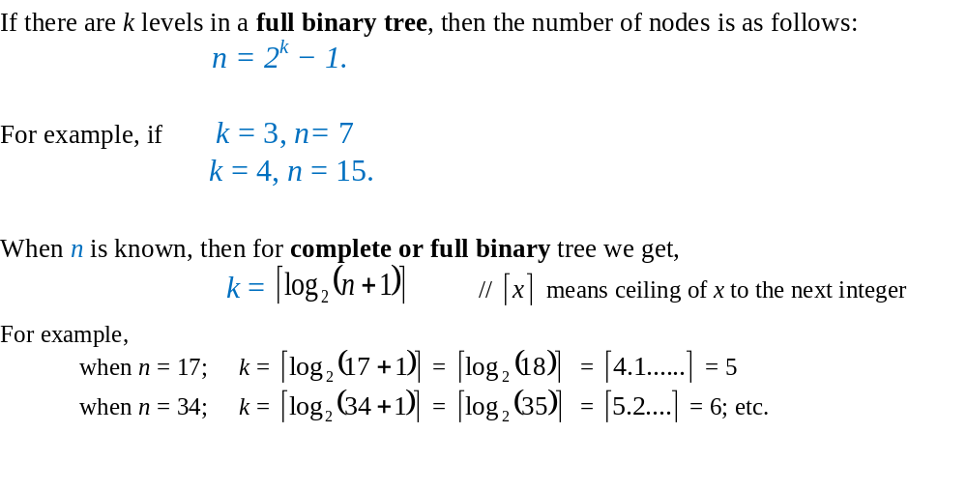
Binary Tree

Slide 25
Binary Tree in Array
Parent child relationship(from parent to child):
If we consider the root’s position is 0,
Parent’s position(index) = i,
Left child’s position(index) = 2i+1,
Right child’s position(index) = 2i+2.

Slide 26
Parent Child Relationship
0
i = 1
2i + 1=3
2i+2 =4
Slide30

Slide 27
Binary Tree in Array
Child parent relationship (from child
to parent):
Child’s position (index): k
Parent’s position: (k-1)/2,
Where / denotes Integer division.

Slide 28
Child Parent Relationship
0
1
(k-1)/2
3
( k )
Slide32

Slide 29
Binary Tree in Array
Parent child relationship(from parent to child):
If we consider the root’s position is 1,
Parent’s position(index) = i,
Left child’s position(index) = 2i,
Right child’s position(index) = 2i + 1.

Slide 30
Parent Child Relationship
1
2
( i )
4
( 2i )
5
( 2i+1 )
Slide 27

Slide 31
Binary Tree in Array
Child parent relationship (from child
to parent):
Child’s position (index): k
Parent’s position: k/2, / denotes
Integer division.
If the binary tree is a complete then array representation is efficient.

Slide 32
Child Parent Relationship
1
2
(k/2 )
5
( k )
Slide 28

Slide 33
Linked representation of Binary Tree
struct node
{
int data;
node *lchild; //pointer to left child
node *rchild; //pointer to right child
};
If the tree is not complete then linked
representation is efficient.

Slide 34
Traversal Technique of a Binary Tree
There are three main traversal techniques (methods) for a binary tree. Such as
  Pre-order Traversal Method
  In-order Traversal Method
  Post-order Traversal Method

Slide 35
Pre-order Traversal Method
  Visit the root (node).
  Traverse the left sub-tree (in pre-order)
  Traverse the right sub-tree (in pre-order)

Slide 36
Example: Preorder
43
31
64
20
40
56
89
28
33
47
59
43
31
20
28
40
33
64
56
47
59
89
Slide 36

Slide 37
Another Example of Preorder
1
A
2
6
B
C
3
5
7
9
D
E
F
G
4
8
10
H
I
J
Figure 7.5: Pre-order traversal method
Visiting sequence:
A B D H E C F I G J

Slide 38
Pre-order Traversal Method
Algorithm 7.1: Algorithm for pre-order traversal
  1. Input a binary tree
  2. preorder (node * curptr)
  {
  if (curptr!= NULL)
  {
  print curptr→data;
  preorder (curptr→lchild);
  preorder (curptr→ rchild);
  }
  }
  3. Output: the information of the nodes.

Slide 39
Array based algorithm for preorder method
preorder (int i, int tree [ ])
{
if (i<n) cout<< tree[i];
preorder (2*i+1, tree);
preorder(2*i+2, tree);
main()
{
input tree[n]// an array of size n
preorder (0, tree);
}

Slide 40
Inorder Traversal
Traverse the left subtree (inorder).
Visit the root (node).
Traverse the right subtree (inorder).

Slide 41
Example: Inorder
We can see the output is a sorted sequence in ascending order
43
31
64
20
40
56
89
28
33
47
59
20
28
31
33
40
43
47
56
59
64
89
Slide 40

Slide 42
In-order Traversal
5
5
A
A
3
8
3
8
B
C
B
C
2
4
7
9
1
4
7
9
D
E
F
G
D
E
F
G
1
6
10
2
6
10
H
I
J
H
I
J
Fig-(a)
Fig-(b)
Visiting Sequences:
H D B E A I F C G J D H B E A I F C G J

Slide 43
In-order Traversal Method
Algorithm 7.2: Algorithm for in-order traversal
1. Input a binary tree.
2. inorder (node * curptr)
{
if (curptr!= NULL)
{
inorder (curptr→lchild);
print curptr→data;
inorder (curptr→rchild);
}
}
3. Output: the information of the nodes.

Slide 44
Postorder Traversal
Traverse the left subtree (postorder).
Traverse the right subtree (postorder).
Visit the root (node).

Slide 45
Example: Postorder
43
31
64
20
40
56
89
28
33
47
59
28
20
33
40
31
47
59
56
89
64
43
Slide 44

Slide 46
Post-order Traversal Method
Algorithm 7.3: Algorithm for post-order traversal
1.Input a binary tree.
2. postorder (node * curptr)
{
if (curptr!= NULL)
{
postorder (curptr→lchild);
postorder (curptr→rchild);
print curptr→data;
}
}
3. Output: the information of the nodes.

Slide 47
Expression Tree
A Binary Tree built with operands and operators.
Also known as a parse tree.
Use in compilers.

Slide 48
Example: Expression Tree
+
/
/
1
3
*
4
6
7
1/3 + 6*7 / 4
Slide47

Slide 49
Binary Search Tree(BST)
A BST is a Binary Tree such that:
Every node entry has a unique key or value.
All the values in the left subtree of a node are smaller(less) than the value of the node.
All the values in the right subtree of a node are greater than the value of the node.
Left and rigt sub-trees are also BST.

Slide 50
Example 1:
Key or value is an integer
43
31
64
20
40
56
89
28
33
47
59

Slide 51
Example 1:
key or value is an integer
43
31
64
20
40
56
89
28
33
47
59

Slide 52
Example 2:
Key or value is a string
Fred
Dan
Mary
Alan
Eve
Kate
Sue
Bill
Eric
Greg
Len
Slide 51

Slide 53
Creation of BST Using Recursive Function
struct node {
int data;
node *lchild;
node *rchild;
};
node *nptr;
//Recursive Function for BST creation
node *creatBST(node *root, int item)
{
if (root==NULL)
{
nptr=new(node);
nptr->data=item; nptr->lchild=NULL; nptr->rchild=NULL;
root=nptr;
return root;
}

Slide 54
Creation of BST Using Recursive Function
else
{
if (item < root->data)
root->lchild=creatBST(root->lchild,item);
else if (item> root->data)
root->rchild=creatBST(root->rchild,item);
else cout<<"Duplicate not allowed";
return root;
}
}

Slide 55
Main function and Recursive function
int main()
{
node *root;
root=NULL;
int i, item;
for(i=0; i<5;++i)
{
cin>>item;
root=creatBST(root, item);
}
//call inorder( ) to print data
return 0;
}

Slide 56
Searching a particular node
Compare with the root if equal then found.
Else if the node value is less search the left subtree.
Otherwise (for greater) search the right subtree.
Searching cost is O(log₂n) if BST is a complete.

Slide 57
Searching
Example:
59
43
31
64
20
40
56
89
28
33
47
59
57
found

Slide 58
Searching
Example:
61
43
31
64
20
40
56
89
28
33
47
59
57
failed

Slide 59
Searching Algorithm
Algorithm 7.4: Algorithm to find out a particular node value of BST
  Input BST and a node value, x;
  Repeat Step-3 to Step-5 until we find the value or we go beyond the tree.
  If x is equal to root node value, searching is successful (print “Found”) and terminate the algorithm.
  If x is less than root node value, we have to search the left sub-tree (by treating it as a BST).
  Else we have to search right sub-tree (by treating it as a BST).
  Otherwise the node value is not present in BST (print “Not Found”).
  Output: Print message “FOUND” or “NOT FOUND”

Slide 60
Insert or Add
Create new node for the item.
Find the parent node the node.
Add or Attach new node as a leaf.

Slide 61
Insert or Add
35
Example:
43
31
64
20
40
56
89
28
33
47
59

Slide 62
Insert or Add
35
Example:
43
31
64
20
40
56
89
28
33
47
59
35

Slide 63
Algorithm to Add
Algorithm 7.5: Algorithm to insert (add) a node to a BST
  1. Input BST and a new node;
  2. Repeat Step-3 to Step-5 until we find the value or we go beyond the tree.
  3. If x is equal to root node value, searching is successful and terminate the algorithm.
  4. If x is less than root node value, we have to search the left sub-tree (by treating it as a BST).
  5. Else we have to search right sub-tree (by treating it as a BST).
  6. If the new node is less the parent node link new node as a left child.
  7. Otherwise link the new node as a right child.
  8. Output: Updated BST.

Slide 64
Delete a node from BST
  Find or locate the node (searching)
  Case 1:
  if the target node is a leaf node, then we just delete the node.
  Case 2:
  if the target node has only one child, then we make link between the child and parent node of the target node and delete the node.

Slide 65
Deletion from BST
  Case 3:
  if the target node has two children (with grand children also).
  Search left sub-tree of the target node and find the node with maximum value and mark it.
  Replace the node value by the maximum value.
  Delete the marked node (the node with maximum value).
  (We can do it using right subtree also in thet case minimum value will be used).

Slide 66
Deletion from BST
Example of Case 3:
43
31
64
Node to be deleted
20
40
56
89
28
33
47
59

Slide 67
Deletion from BST
Example of case 3:
43
31
64
Node to be deleted
20
40
56
89
28
33
47
59
Node with max value

Slide 68
Deletion from BST
Example of case 3:
43
31
59
Replaced the value
20
40
56
89
28
33
47
59
Node with max value

Slide 69
Deletion from BST
Example of Case 3:
43
31
59
20
40
56
89
28
33
47
Deletion is performed

Slide 70
Inorder Traversal of a BST
We can see the output is a sorted sequence in ascending order
43
31
64
20
40
56
89
28
33
47
59
20
28
31
33
40
43
47
56
59
64
89

Slide 71
Heap
It is a complete binary tree.
each node value is greater or smaller than the node value of its children.

Slide 72
Shape of a Complete Binary Tree

Slide 73
Types of Heap
  Max-heap and Min-heap
  If the node value is greater than the node value of its children, then the heap is called max heap.
  Otherwise, the heap is called min heap.
  Array implementation of a heap is efficient.

Slide 74
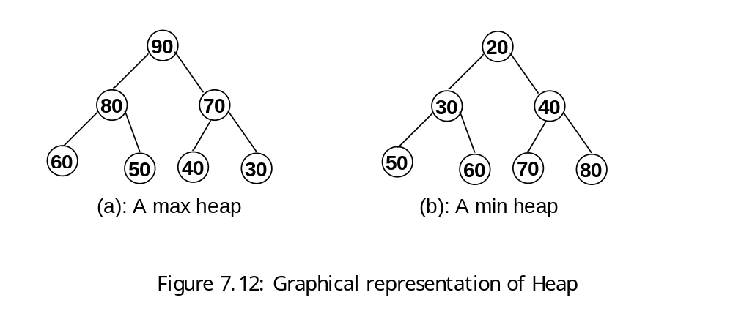
Heap [contd.]

Slide 75
Heap Creation Process
  Add an element as root of the heap.
  Select second element as left child and place it in proper position by comparing it with its parent.
  Select next element as right child and place it in proper position by comparing it with its parent.
4. Select next element as left or right child and
place it in proper position by comparing it with
is parent and grant parents (if any).

Slide 76
Heap Creation [contd.]
We have to compare parent and child and check whether parent is smaller if smaller, swap the elements.
By repeating the process we can have a max-heap.

Slide 77
Heap Creation [contd.]
  Given List: 45 28 52 25 60 70
  Create heap using the above data.

Slide 78
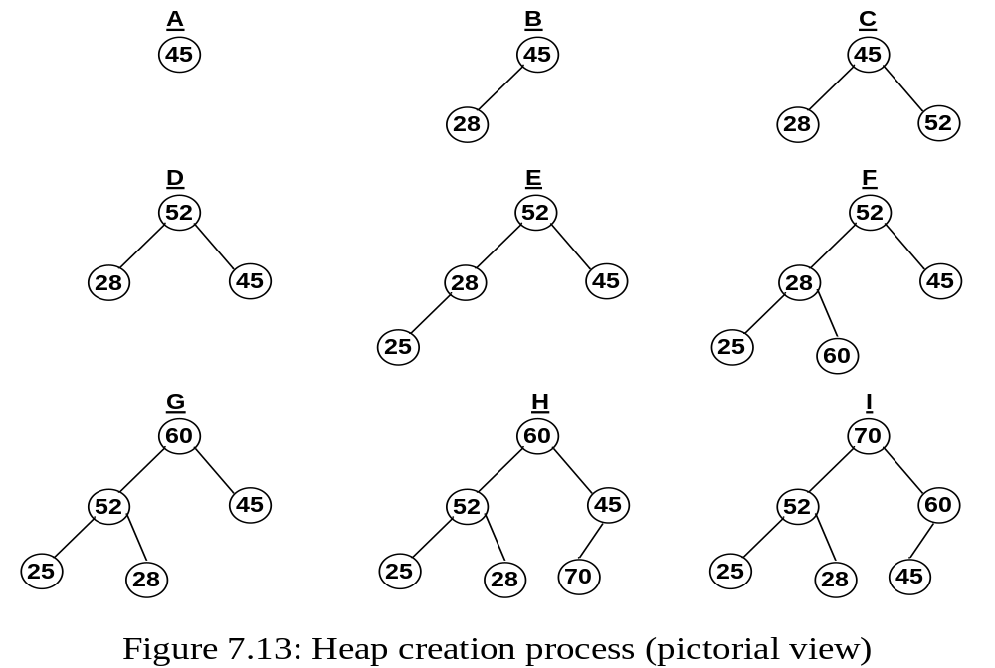
Heap Creation [contd.]

Slide 79
Algorithm to create a heap
(pseudocode)
  Take an array, A[1:n] with data and a variable, temp
  [we shall consider and rearrange data using temp one by one]
    2. for (i = 2; i<=n; ++i)
    {
  temp=a[i];
    k = i;
    while (k > 0 and A[k/2] < temp)
    {
    A[k] = A[k/2]; //copy parent’s value to child’s position
    k = k/2; //consider data of upper/parent’s position
    }
    A[k] = temp;
    } // end of for
  3. Output: a heap

Slide 80
Delete maximum from a max-heap
1. Take last data in temporary variable (temp = a[n])
2. Assume there is a hole at the root node.
3. Compare greater child of the hole with data in temp and place the greater one in the hole (root).
4. Repeat step 3 until there is no hole or the hole becomes a leaf node.
5. Place the value of temp in the hole at the last level.

Slide 81
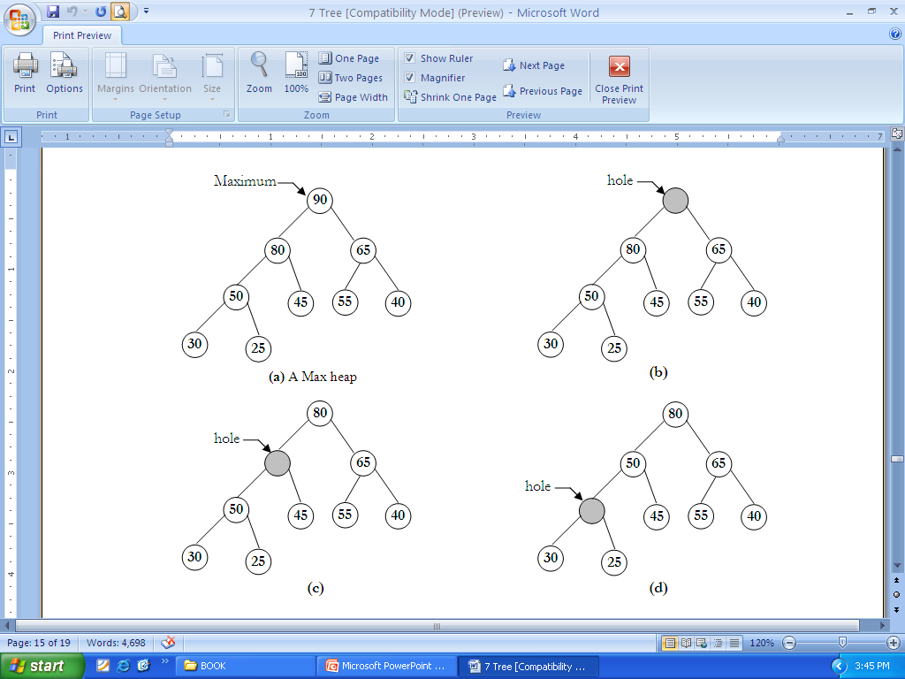
Delete maximum from a max-heap [contd.]
Temp = 25

Slide 82
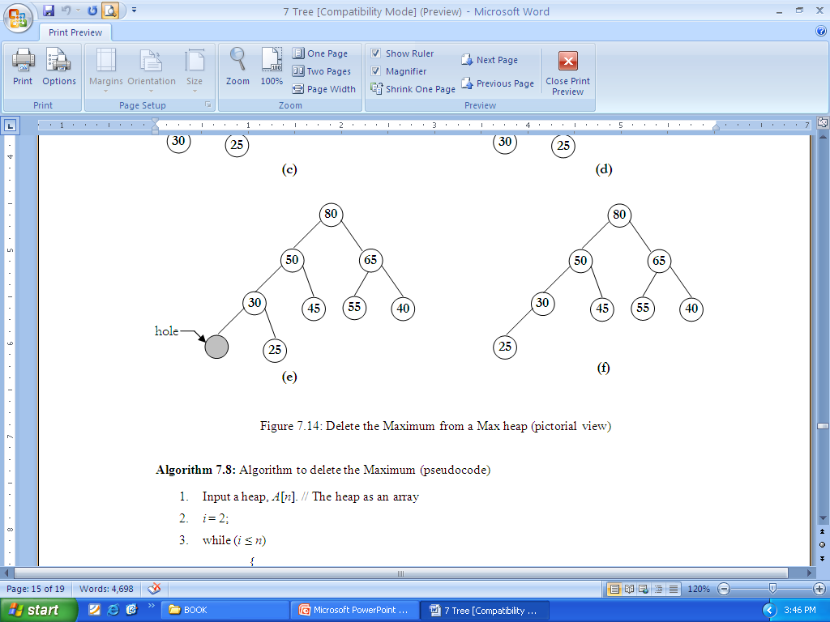
Delete maximum from a max-heap [contd.]
Temp = 25
Put value of temp in hole at last level

Slide 83
Algorithm to delete the Maximum (pseudocode)
  Input a heap, a[1:n]. // The heap as an array
  temp= a[n]; //data of last position is in temp
  i = 2;
  while (i<=n)
  {
  if ((i<n) and (a[i]<a[i+1])) // find greater child
  i= i+1;
  If (temp>=a[i] break; //if temp is greater than greater child, stop
  a[i/2]=a[i]; i=2*I //copy child’s value to parent’s position
  }
  a[i/2]=temp;
  5. Output updated heap with (n − 1) elements.

Slide 84
Heapsort
1. Create heap
2. Place the last node value in a temporary place
3. Place the root node value in the last place
4. Rearrange the tree except last node
5. Repeat step 2 to 4.(online)

Slide 85
Heap sort in detail
  Create a heap with n numbers. We can create heap using the heap creation algorithm.
  Place the value of n^{th} (last) node in a temporary variable.
  Place the value of the first node (root at present) in the n^{th} position.
  Treat there is a hole at the root.
  Compare the children of the hole and place the greater child in the hole.
  Repeat step-5 until the hole is a leaf node.
  Place the value in the temporary place in the (last) hole.
  Consider the rest of the data (which are in a heap) except last one.
  Repeat the step-2 to step-7 until there is only one element in the heap.

Slide 86
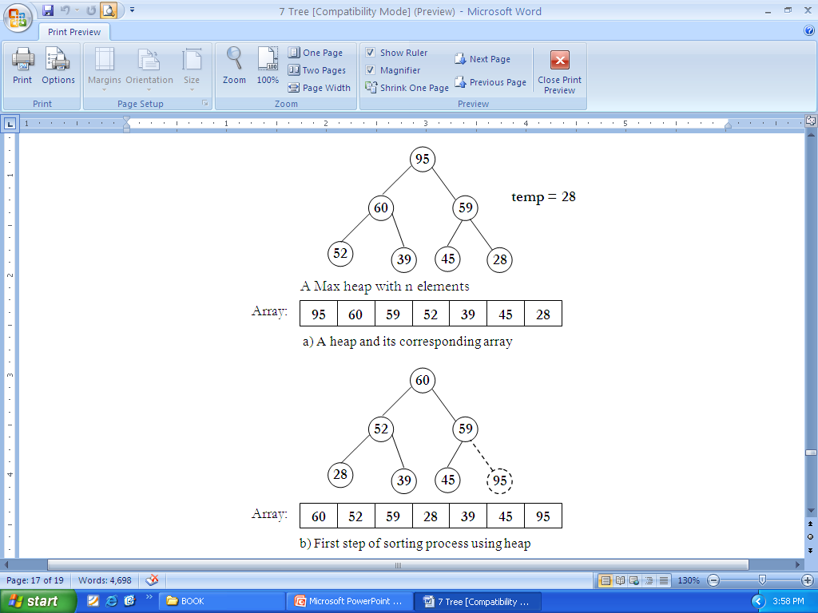
Heap sort [contd.]

Slide 87
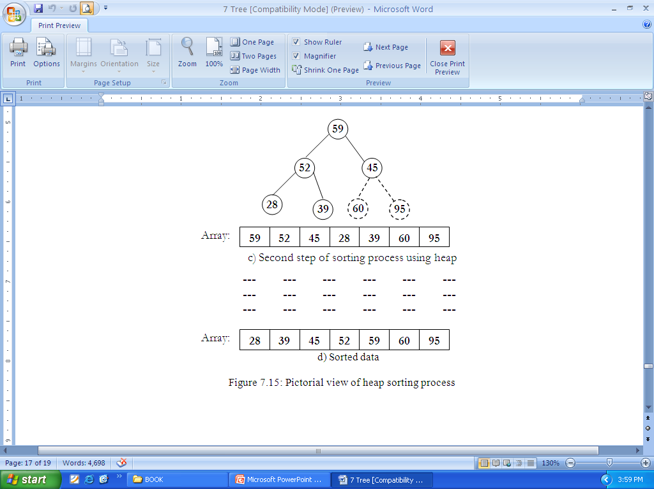
Heap sort [contd.]
Temp =45

Slide 88
Heap Sort
Input an array, a[1:n] with random data
heapify (a, n);
for (k = n; k>1; --k)
rearange (a, k);
Output a sorted list in a [1:n];
Here heapify and rearange are two functions. Then function heapify builds a heap and rearange function adjusts data for sorting.

Slide 89
THANK YOU

